Slide 1
PROBLEMS

Slide 2
An infinite nonconducting sheet has a surface charge density σ= 0.10 μC/m² on one side. How far apart are equipotential surfaces whose potentials differ by 50 V?

Slide 3
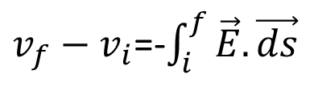
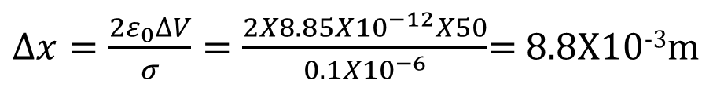
An infinite non conducting sheet has a surface charge density 0.10 μC/m² on one side. How far apart are equipotential surfaces whose potentials differ by 50 V?
$v_{f}−v_{i}$=-$\int_{i}^{f}{\vec{E}.\vec{ds}}$
ΔV = EΔx = ( σ /2ε₀)Δx.
$∆x=\frac{2ε_{0}∆V}{σ}=\frac{2X8.85X{10}^{−12}X50}{{0.1X10}^{−6}}$= 8.8X10⁻³m

Slide 4
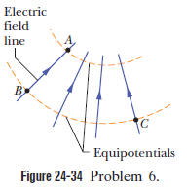
When an electron moves from A to B along an electric field line in Fig. 24-34, the electric field does 3.94x10⁻¹⁹ J of work on it. What are the electric potential differences (a) V_{B}-V_{A} (b) V_{C}- V_{A}, and (c) V_{C}-V_{B}?

Slide 5
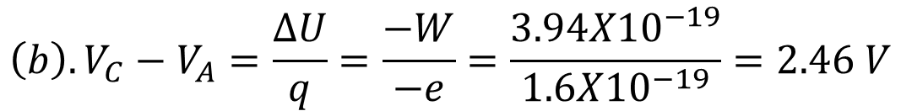
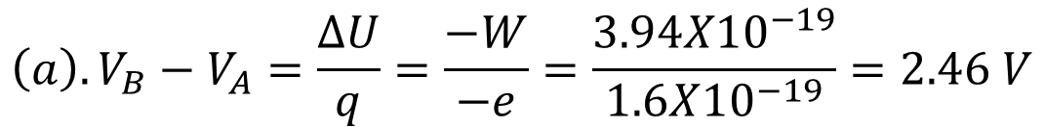

When an electron moves from A to B along an electric field line in Fig. 24-34, the electric field does 3.94x10⁻¹⁹ J of work on it. What are the electric potential differences (a) V_{B}-V_{A} (b) V_{C}- V_{A}, and (c) V_{C}-V_{B}?
$${\left(a\right). V}_{B}−V_{A}=\frac{∆U}{q}=\frac{−W}{−e}=\frac{{3.94X10}^{−19}}{1.6X{10}^{−19}}=2.46 V$$
$${\left(b\right). V}_{C}−V_{A}=\frac{∆U}{q}=\frac{−W}{−e}=\frac{{3.94X10}^{−19}}{1.6X{10}^{−19}}=2.46 V$$
$${\left(c\right) V}_{C}−V_{B}=0$$

Slide 6
The electric field in a region of space has the components Ey=Ez= 0 and Ex= (4.00 N/C)x. Point A is on the y axis at y =3.00 m, and point B is on the x axis at x =4.00 m. What is the potential difference V_{B}- V_{A}?

Slide 7
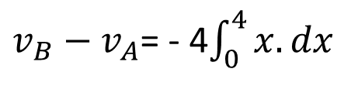
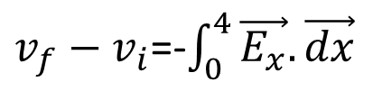
The electric field in a region of space has the components Ey=Ez= 0 and Ex= (4.00 N/C)x. Point A is on the y axis at y =3.00 m, and point B is on the x axis at x =4.00 m. What is the potential difference V_{B}- V_{A}?
We connect A to the origin with a line along the y axis, along which there is no change of potential Then, we connect the origin to B with a line along the x axis, along which the change in potential is
$v_{f}−v_{i}$=-$\int_{0}^{4}{\vec{E_{x}}.\vec{dx}}$
$v_{B}−v_{A}$= - 4$\int_{0}^{4}{x.dx }$
which yields, V_{B} – V_{A} = –32.0 V.

Slide 8
A nonconducting sphere has radius R= 2.31 cm and uniformly distributed charge q=3.50 fC. Take the electric potential at the sphere’s center to be V₀ =0. What is V at radial distance (a) r = 1.45 cm and (b) r = R.

Slide 9
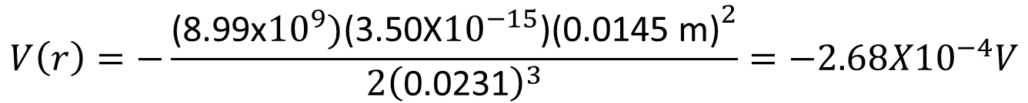
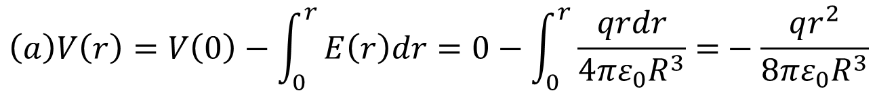
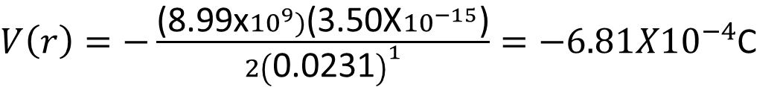
A nonconducting sphere has radius R= 2.31 cm and uniformly distributed charge q=3.50 fC. Take the electric potential at the sphere’s center to be V₀ =0. What is V at radial distance (a) r = 1.45 cm and (b) r = R.
$$\left(a\right)V\left(r\right)=V\left(0\right)−\int_{0}^{r}{E\left(r\right)dr=0−\int_{0}^{r}{\frac{qrdr}{4πε_{0}R^{3}}=}}−\frac{qr^{2}}{8πε_{0}R^{3}}$$
$$V\left(r\right)=−\frac{\text{(8.99}\text{x}{10}^{9})\text{(3.50}\text{X}{10}^{−15}\text{)}{\text{(0.0145 }\text{m}\text{)}}^{2}}{2{\left(\text{0.0231}\right)}^{3}}={−2.68X10}^{−4}V$$
(b) Since ΔV = V(0) – V(R) = q/8πε0R, we have
$V\left(r\right)=−\frac{\text{(8.99}\text{x}{10}^{9})\text{(3.50}\text{X}{10}^{−15}\text{)}}{2{\left(\text{0.0231}\right)}^{1}}={−6.81X10}^{−4}$C

Slide 10
A charge of magnitude q is divided into two parts such that force between resulting two charges is maximum when separated through some distance r. The division of charges would be

Slide 11
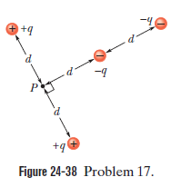
In Fig. 24-38, what is the net electric potential at point P due to the four particles if V= 0 at infinity, q = 5.00 fC, and d= 4.00 cm?

Slide 12
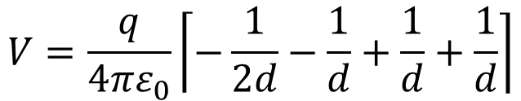
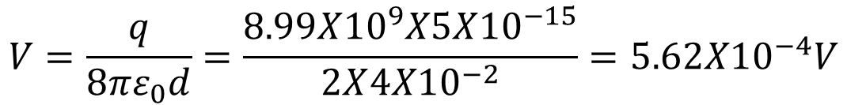
In Fig. 24-38, what is the net electric potential at point P due to the four particles if V= 0 at infinity, q = 5.00 fC, and d= 4.00 cm?
$$V=\frac{q}{4πε_{0}}\left\lceil −\frac{1}{2d}−\frac{1}{d}+\frac{1}{d}+\frac{1}{d}\right\rceil$$
$$V=\frac{q}{8πε_{0}d}=\frac{8.99X{10}^{9}X5X{10}^{−15}}{2X{4X10}^{−2}}=5.62X{10}^{−4}V$$

Slide 13
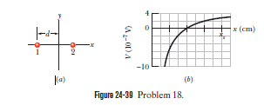
Two charged particles are shown in Fig. 24-39a. Particle 1, with charge q₁, is fixed in place at distance d. Particle 2, with charge q2, can be moved along the x axis. Figure 24-39b gives the net electric potential V at the origin due to the two particles as a function of the x coordinate of particle 2. The scale of the x axis is set by x_{s}= 16.0 cm. The plot has an asymptote of V = 5.76 X 10⁻⁷ V as x tends to infinity. What is q2 in terms of e?

Slide 14

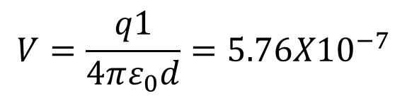
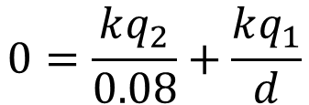
Two charged particles are shown in Fig. 24-39a. Particle 1, with charge q₁, is fixed in place at distance d. Particle 2, with charge q2, can be moved along the x axis. Figure 24-39b gives the net electric potential V at the origin due to the two particles as a function of the x coordinate of particle 2. The scale of the x axis is set by x_{s}= 16.0 cm. The plot has an asymptote of V = 5.76 X 10⁻⁷ V as x tends to infinity. What is q2 in terms of e?
When the charge q2 is infinitely far away, the potential at the origin is due only to the charge q1 :
$$V=\frac{q1}{4πε_{0}d}=5.76X{10}^{−7}$$
Thus, q1/d = 6.41 × 10⁻¹⁷ C/m. Next, we note that when q2 is located at x = 0.080 m, the net potential vanishes (V1 + V2 = 0). Therefore,
$$0=V_{1}+V_{2}$$
$$0=\frac{kq_{2}}{0.08}+\frac{kq_{1}}{d}$$
Thus, we find q2 = −(q1 / d)(0.08 m) = –5.13 × 10⁻¹⁸ C = –32 e.

Slide 15
The electric potential at points in an xy plane is given by V = (2.0 V/m₂)x² - (3.0 V/m²)y². In unit-vector notation, what is the electric field at the point (3.0 m, 2.0 m)?

Slide 16
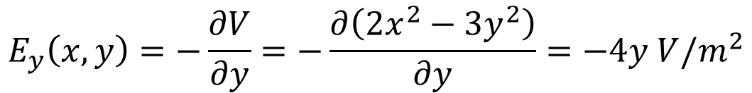
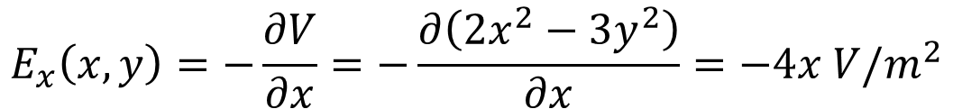

The electric potential at points in an xy plane is given by V = (2.0 V/m₂)x² - (3.0 V/m²)y². In unit-vector notation, what is the electric field at the point (3.0 m, 2.0 m)?
$$E_{x}\left(x,y\right)=−\frac{∂V}{∂x}=−\frac{∂\left(2x^{2}−3y^{2}\right)}{∂x}=−4x V/m^{2}$$
$$E_{y}\left(x,y\right)=−\frac{∂V}{∂y}=−\frac{∂\left(2x^{2}−3y^{2}\right)}{∂y}=−4y V/m^{2}$$
We evaluate at x = 3.0 m and y = 2.0 m to obtain
$$\vec{E}=−12\hat{i}+12\hat{j}$$

Slide 17
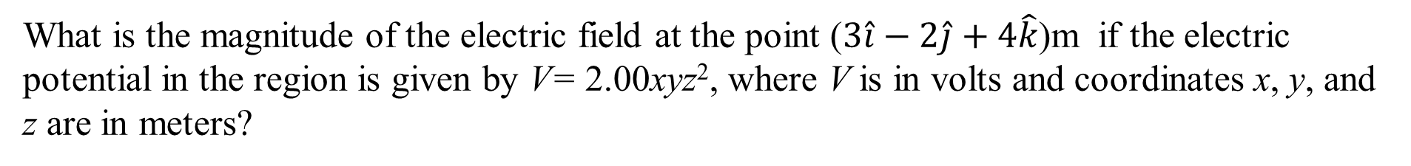
What is the magnitude of the electric field at the point ($3\hat{i}−2\hat{j}+4\hat{k}$)m if the electric potential in the region is given by V= 2.00xyz², where V is in volts and coordinates x, y, and z are in meters?

Slide 18
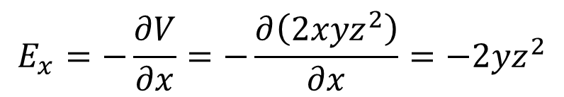
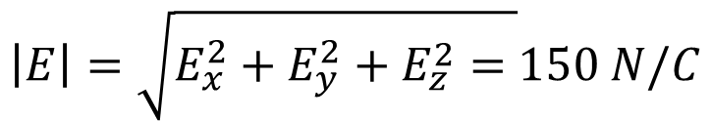
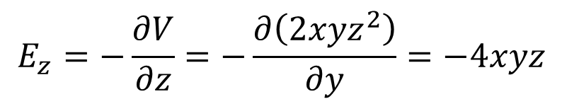
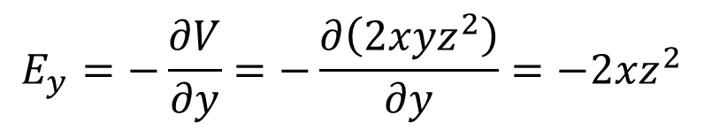
What is the magnitude of the electric field at the point ($3\hat{i}−2\hat{j}+4\hat{k}$)m if the electric potential in the region is given by V= 2.00xyz², where V is in volts and coordinates x, y, and z are in meters?
$$E_{x}=−\frac{∂V}{∂x}=−\frac{∂\left(2xyz^{2}\right)}{∂x}=−2yz^{2}$$
$$E_{y}=−\frac{∂V}{∂y}=−\frac{∂\left(2xyz^{2}\right)}{∂y}=−2xz^{2}$$
$$E_{z}=−\frac{∂V}{∂z}=−\frac{∂\left(2xyz^{2}\right)}{∂y}=−4xyz$$
which, at (x, y, z) = (3.00 m, –2.00 m, 4.00 m), gives
(Ex, Ey, Ez) = (64.0 V/m, –96.0 V/m, 96.0 V/m).
The magnitude of the field is therefore
$$\left|E\right|=\sqrt{E_{x}^{2}+E_{y}^{2}+E_{z}^{2}= }150 N/C$$

